Slide 1
ENHANCING FLOWER CLASSIFICATION THROUGH CNN
R.RAJESH
613521104032
THIRD YEAR CSE

Slide 2

INTRODUCTION
Welcome to the presentation on Enhancing Flower Classiﬁcation through CNN. This session will cover the agenda, problem statement, overview, solutions, end users, and results. Let's delve into the world of ﬂower classiffication!

Slide 3

Agenda
PROBLEM STATEMENT
OVERVIEW
SOLUTIONS
END USERS
CHALLENGES
RESULTS
MODEL PERFORMANCE
FUTURE IMPLICATIONS

Slide 4

PROBLEM STATEMENT
The ﬂower classiffication problem involves accurately identifying and categorizing different types of ﬂowers.
Traditional methods have limitations in handling diverse ﬂower species and variations.
This presentation addresses these challenges.

Slide 5

Overview
This section provides an in- depth overview of the ﬂower classiffication problem, including the importance of accurate classiﬁcation and the limitations of existing methods. It sets the stage for the proposed solutions.

Slide 6
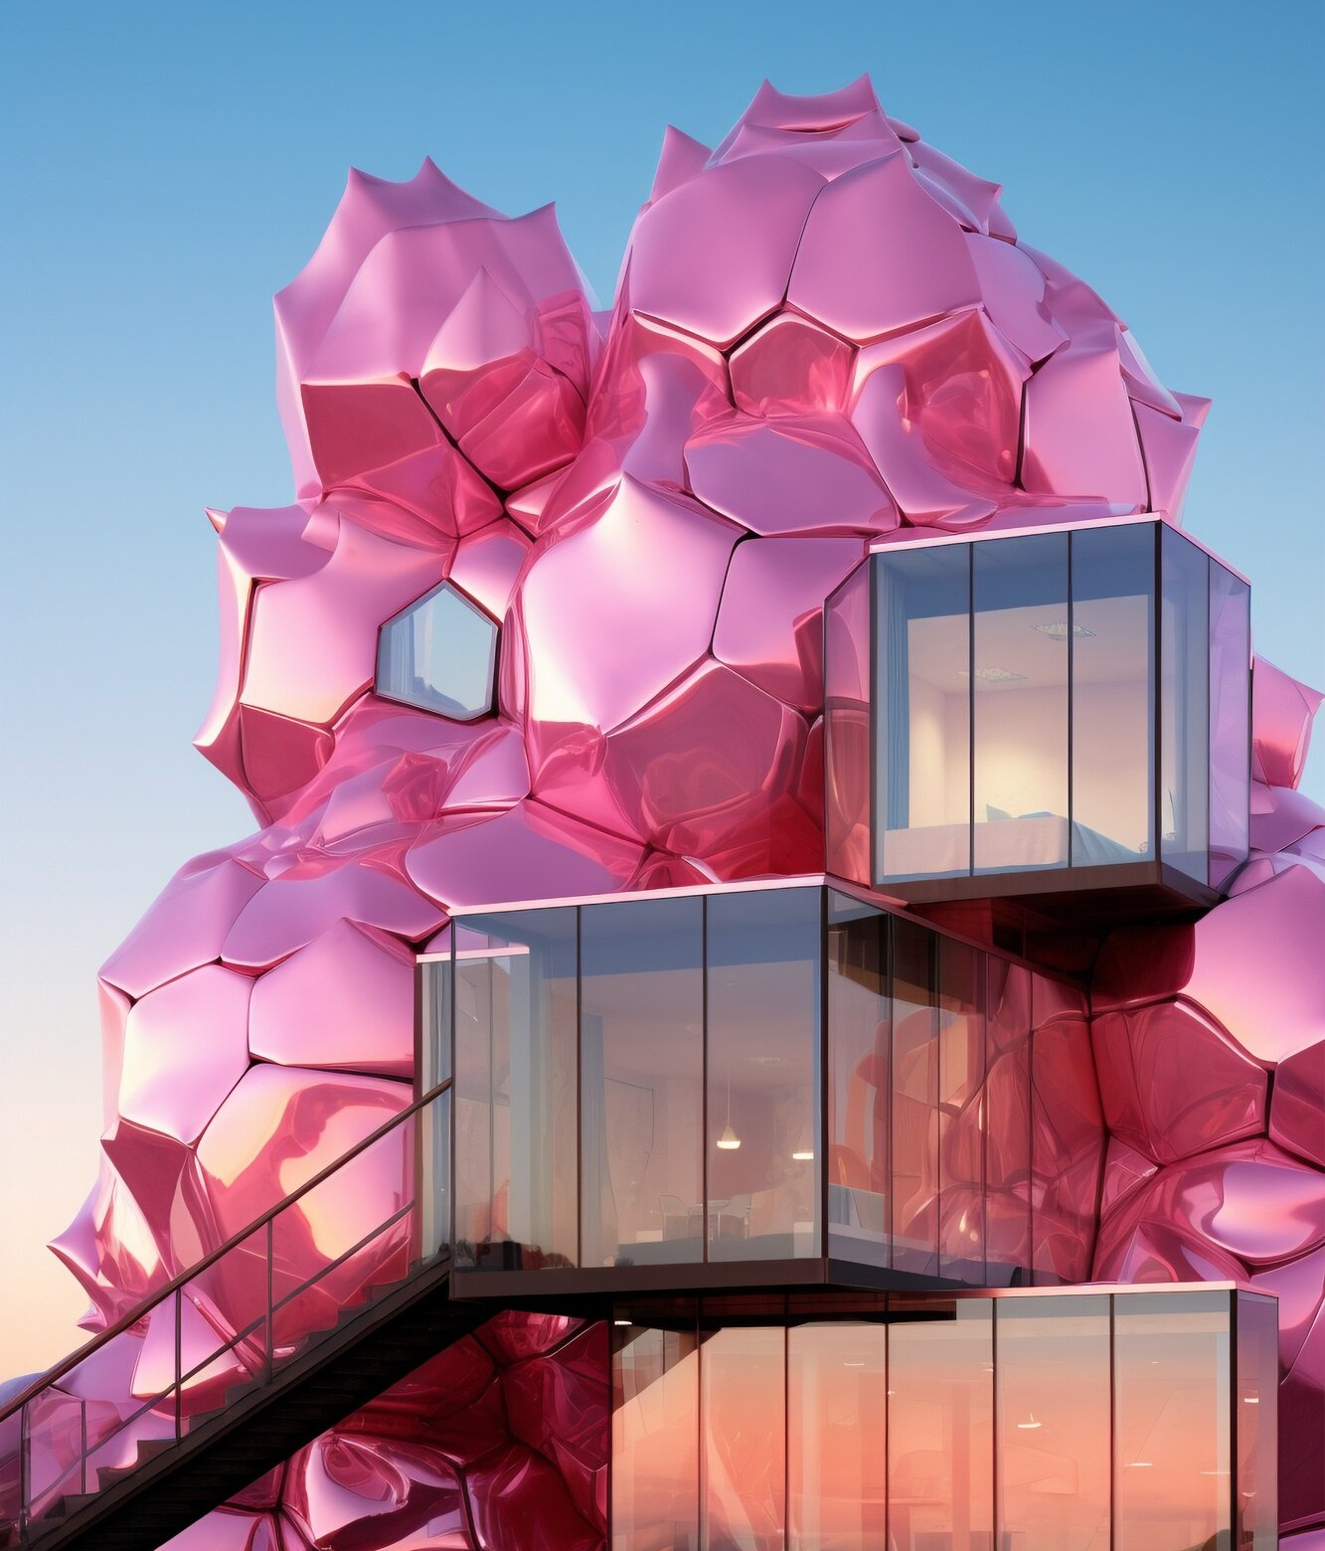
SOLUTIONS
Utilizing Convolutional Neural Networks (CNN) offers a promising solution for enhancing ﬂower classiffication. This section explores how CNN can effectively handle the complexities of ﬂower images and improve classiﬁcation accuracy.

Slide 7

END USERS
The proposed solutions aim to beneﬁt a wide range of end users, including botanists, horticulturists, ﬂorists, and researchers. These advancements in ﬂower classiﬁcation have practical implications for various domains.

Slide 8

CHALLENGES
While discussing the results, it's essential to address the challenges encountered during the implementation of CNN-based ﬂower classiffication. This section emphasizes the need for ongoing reﬁnement and adaptation.

Slide 9
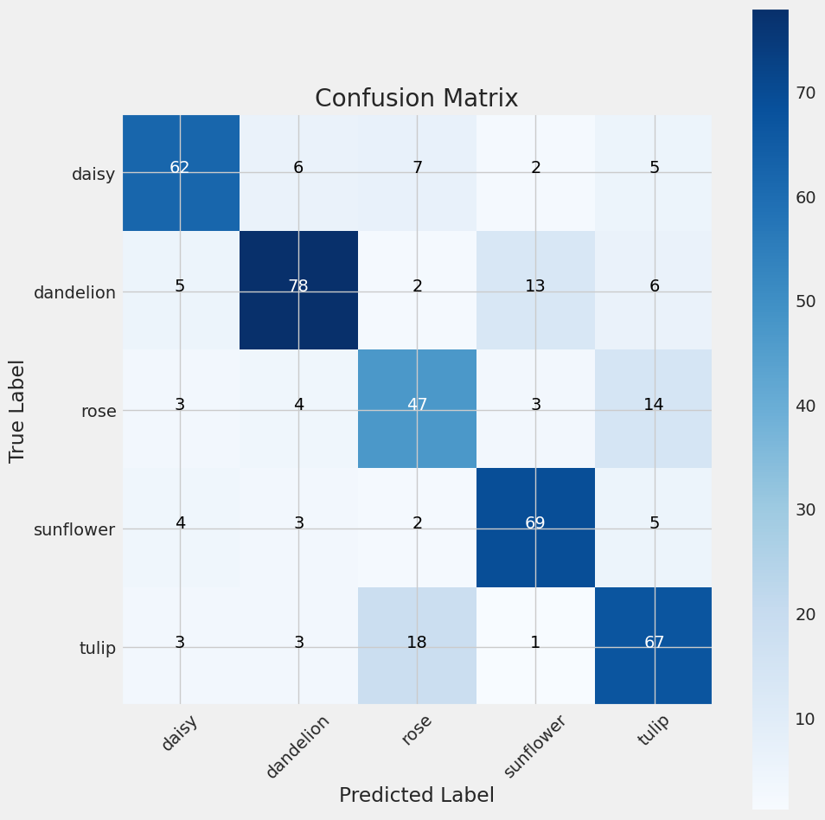
RESULTS
The flower is predicted based on trained model and displayed in confusion matrix.
This confusion matrix shows that predicted flower was dandelion.

Slide 10
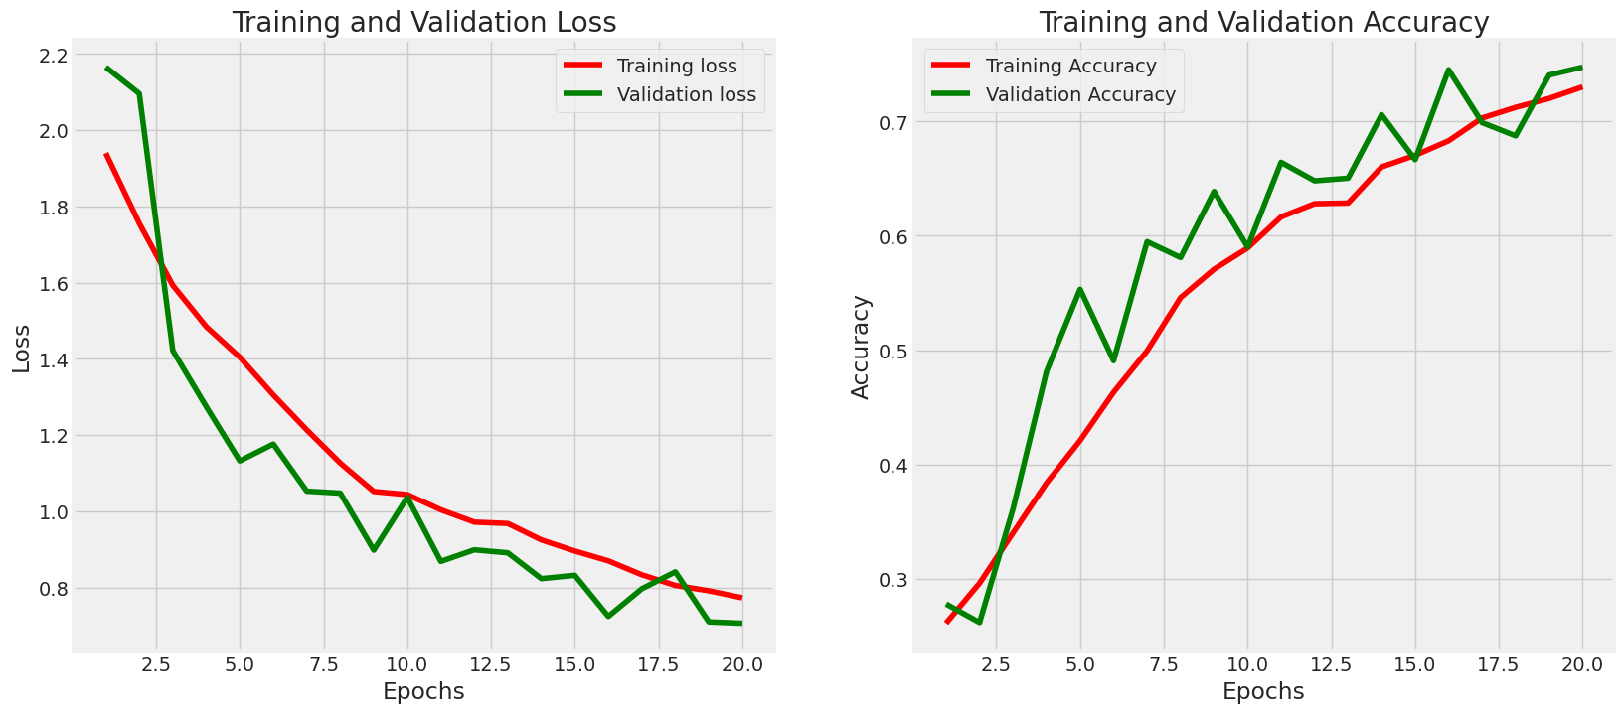
MODEL PERFORMANCE

Slide 11

Future Implications
Looking ahead, this section explores the broader implications of enhanced ﬂower classiffication through CNN. It delves into potential future developments and applications in related ﬁelds.

Slide 12
CONCLUSION
In conclusion, this presentation has shed light on the signifficance of enhancing ﬂower classiffication through CNN. It emphasizes the impact on diverse end users and the potential for further advancements in the ffield.

